Slide 2

Chapter 6
Aseptic Garbing, Hand Washing, and Gloving

Slide 3
Learning Objectives
Gain an awareness of the connections between early concepts of germ transmission and current procedures for aseptic garbing, hand washing, and gloving.
Understand the procedures for aseptic garbing, hand washing, and gloving according to USP Chapter <797> guidelines.
Identify ways that aseptic garbing, hand washing, and gloving protect the patient from infection.
Recognize and respond appropriately to actions that compromise asepsis during aseptic garbing, hand washing, and gloving procedures.
Demonstrate excellent technique in aseptic hand washing, garbing, and gloving.

Slide 4

Topics
Learning Objectives
Introduction
Self-Assessment for Compliance
Use of Personal Protective Equipment
Essential Supplies
Procedure-Specific Supplies
Preview the Lab Procedure
Chapter Summary
In Slide Show view, click the desired topic to the left to link directly to the related slide. To return to this slide at any point in the presentation, click the Topics button below.

Slide 5
Introduction
Garbing, hand washing, and gloving are important components of aseptic technique
  these procedures help avoid the introduction of pathogens, or disease-causing microorganisms, while working with sterile compounding products and supplies
Maintaining asepsis in product preparation is critical for the hospitalized patients receiving these CSPs
Correct garbing, hand washing, and gloving are also important safety measures for those preparing the products

Slide 6
Self-Assessment for Compliance
Before beginning the sterile compounding process, IV technicians must assess their own physical appearance for any violations
  do not wear cosmetics, hair spray, perfume, artificial nails, or nail polish
  remove any jewelry, including body piercings not covered by a gown and mask
  keep your fingernails closely trimmed to make it easier to eradicate the bacteria under the nails
  no weeping sores, sunburn, rash, or respiratory infection

Slide 7
Use of Personal Protective Equipment
Sterile compounding personnel begin the process of donning personal protective equipment (PPE)
  minimize the risk of contamination of the sterile compounding area and the CSPs
In addition to donning PPE, IV technicians also perform an aseptic hand washing, a hand-washing procedure that is more stringent than basic hand washing

Slide 8

Use of Personal Protective Equipment…/2
Aseptic Garbing
IV technicians prepare to work by donning shoe covers, a hair cover, and a face mask

Slide 9
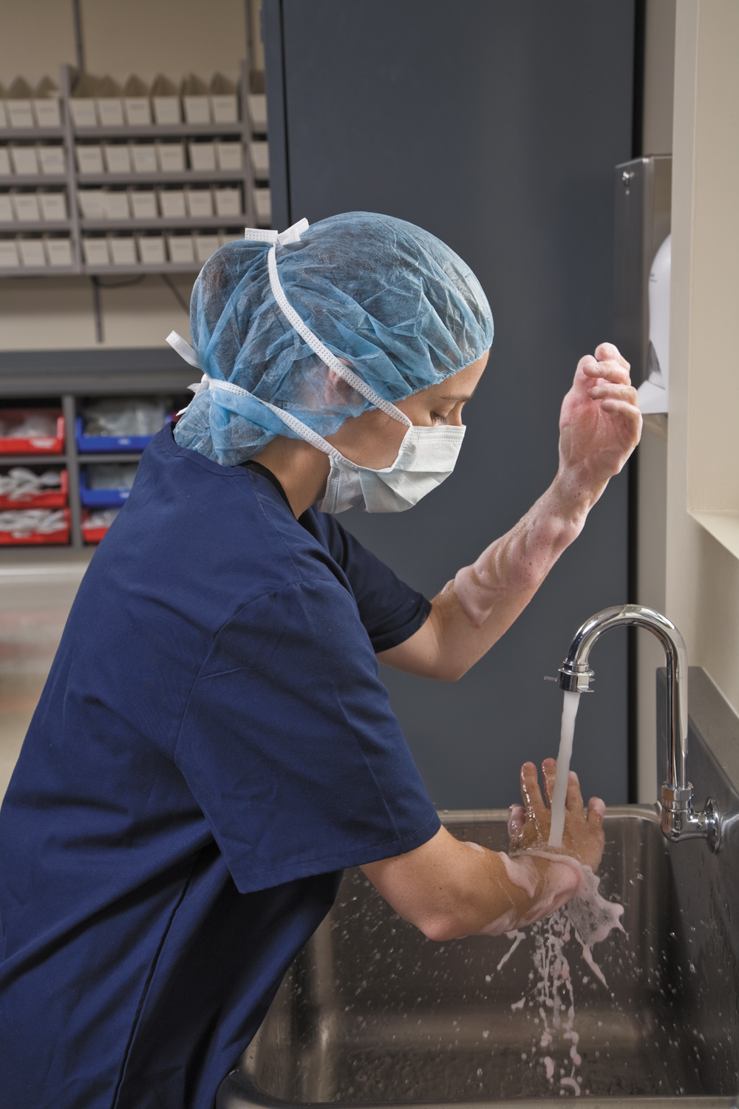
Use of Personal Protective Equipment…/3
Aseptic Hand Washing
IV technicians wash their forearms and hands using an appropriate antimicrobial agent and following a specific sequence

Slide 10
Use of Personal Protective Equipment…/4
Aseptic Hand Washing…continued
Special attention should be paid to areas that harbor multiple microorganisms
  under the fingernails and in the creases of skin
Learning this process is critical because the most common source of contamination in the preparation of parenteral products is touch contamination by a healthcare worker who has not practiced correct aseptic technique in hand washing

Slide 11
Use of Personal Protective Equipment…/5
Aseptic Hand Washing…continued
The following situations require the completion of aseptic hand washing:
  when first entering the sterile compounding area
  when reentering the sterile compounding area
  after eating
  after using the restroom
  after sneezing or coughing
  after a major contamination, such as a needle stick or a drug spill with a volume greater than 5 mL
  after the hands touch any item that is obviously contaminated, such as the floor, the waste receptacle or sharps container, or a visibly soiled item

Slide 12
Use of Personal Protective Equipment…/6
Aseptic Hand Washing…continued
In certain situations, sterile compounding personnel may cleanse their hands or gloves with sterile, foamed 70% isopropyl alcohol (IPA):
  upon entering the anteroom, prior to donning PPE
  after using a calculator or pen
  after spilling a few drops of liquid on the gloved hand
  when there is potential for minor hand contamination such as after adjusting eyeglasses or handling labels or medication orders

Slide 13
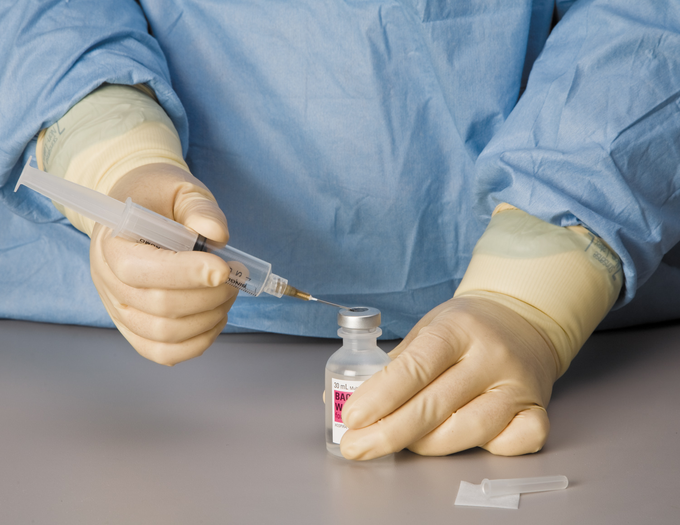
Use of Personal Protective Equipment…/7
Sterile Gown and Gloves
After hand washing has been completed, sterile compounding technicians put on the last two PPE items: a sterile gown and a pair of sterile gloves

Slide 14
Use of Personal Protective Equipment…/8
Sterile Gown and Gloves…continued
A human sheds more than one million skin cells every hour
  cells harbor multiple organisms that could contaminate the sterile products, endangering patient recipients

Slide 15
Use of Personal Protective Equipment…/9
Sterile Gown and Gloves…continued
IV technicians who have aseptically cleansed hands placed inside of sterile gloves have compensated for two possible scenarios:
  the ripping or puncturing of gloves by a needle or glass shard
  the growth of microorganisms on poorly cleansed hands enclosed in the warm, moist environment of gloves; these microorganisms could then seep through the micropores of the gloves

Slide 16
Your Turn
  A hand-washing procedure that is more stringent than basic hand washing is called this.
  complex hand washing
  aesthetic hand washing
  aseptic hand washing
  complete hand washing
In Slide Show view, click here to see the answer to Question 1. Then click again to advance to Question 2.
Microorganisms could seep through these in the gloves.
  minipores
  macropores
  millipores
  micropores
In Slide Show view, click here to see the answer to Question 2.

Slide 17
Essential Supplies
Foot and Head Garb
IV technicians should wear close-toed shoes because of the potential for injury by needles or broken glass
Clean, well-fitting walking or running shoes are a safe option
Sterile compounders also need to place disposable shoe covers over their shoes to keep dirt and other substances from contaminating the clean room floor

Slide 18
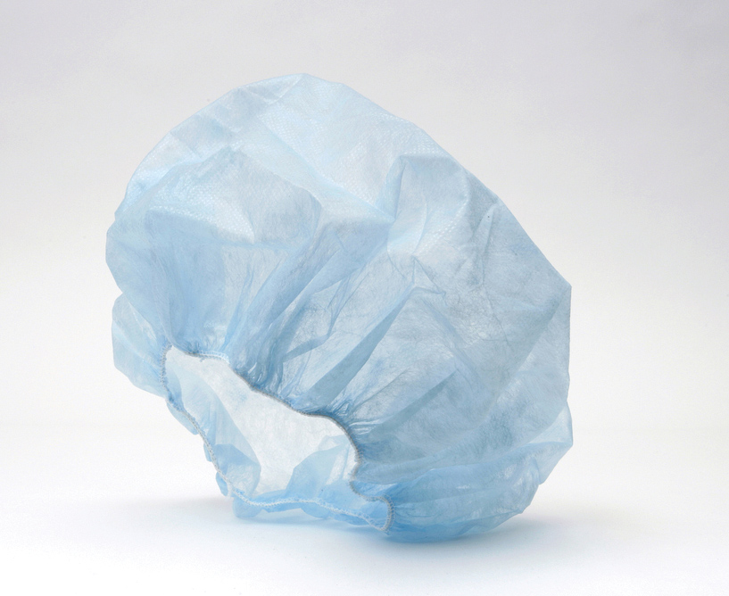
Essential Supplies…/2
Foot and Head Garb…continued
The options for hair covers include disposable caps and washable caps in surgical or bouffant styles
  in general, surgical caps tie behind the head, and bouffant caps have a band of elastic that secure them to the head

Slide 19
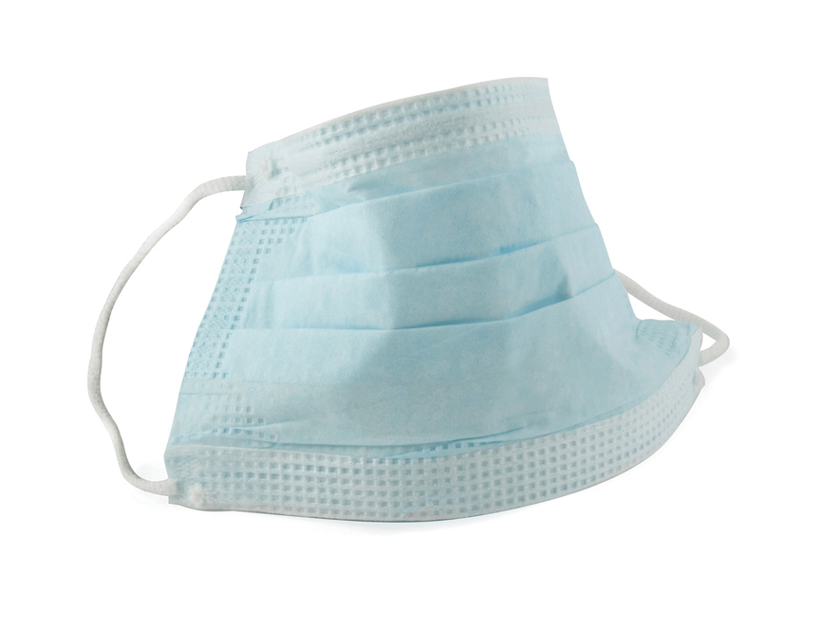
Essential Supplies…/3
Foot and Head Garb…continued
Pharmacy personnel wear face masks to catch the bacteria held in the liquid droplets and aerosols that emanate from the mouth and nose
  IV technicians with facial hair should also wear beard covers

Slide 20
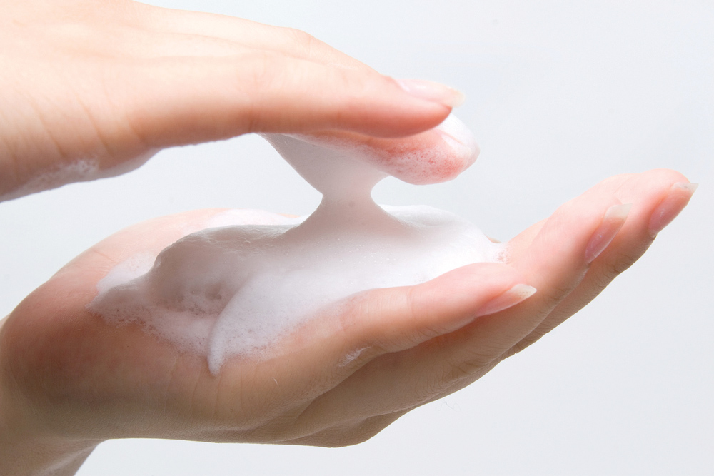
Essential Supplies…/4
Hand Cleansers
Each commonly used type of hand cleanser has benefits and well-defined uses, and compounding facilities choose the types that suit them
  facilities should occasionally change their type of hand cleanser

Slide 21
Essential Supplies…/5
Hand Cleansers…continued
Chloroxylenol is an effective, common cleansing agent appropriate for aseptic hand washing
Chlorhexidine gluconate is also a common and appropriate cleansing agent for aseptic hand washing
Isopropyl alcohol (IPA) rinses, gels, or foams are frequently used prior to donning PPE, and between aseptic hand-washing procedures when there is minor hand contamination from handling labels or medication orders or adjusting eyeglasses

Slide 22
Essential Supplies…/6
Hand Cleansers…continued
Iodophors (such as povidone-iodine) have very effective antimicrobial properties, but they irritate the skin. Thus, sterile compounding technicians typically use this cleansing agent only if nothing else is available
Triclosan, common in household soaps, is appropriate for general hand washing in other areas of the pharmacy, but not acceptable for aseptic hand washing

Slide 23
Essential Supplies…/7
Scrubs, Gowns, and Gloves
Layer attire so that it is appropriate for the warmth level, comfortable and practical
  should don clean scrub uniforms
Must wear either a sterile, lint-free, disposable gown, or a gown that has been freshly laundered and sterilized by the hospital’s laundry department
  should completely cover the front of the technician, have a secure neck closure, tie in the back, and fit snugly around the wrists

Slide 24
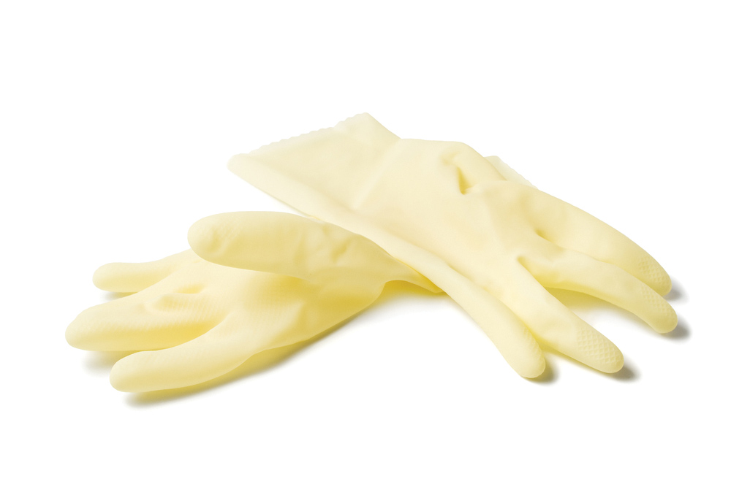
Essential Supplies…/8
Scrubs, Gowns, and Gloves…continued
Technicians should also don sterile, powder-free gloves
  synthetic, nonlatex gloves are available for people with latex allergies

Slide 25
Essential Supplies…/9
Scrubs, Gowns, and Gloves…continued
As a general rule, note that size six gloves are small, size seven gloves are medium, and size eight gloves are large
  should be close-fitting to allow for maximum finger dexterity but not so tight that they compromise circulation or cause discomfort
Gloves are for one-time use only

Slide 26
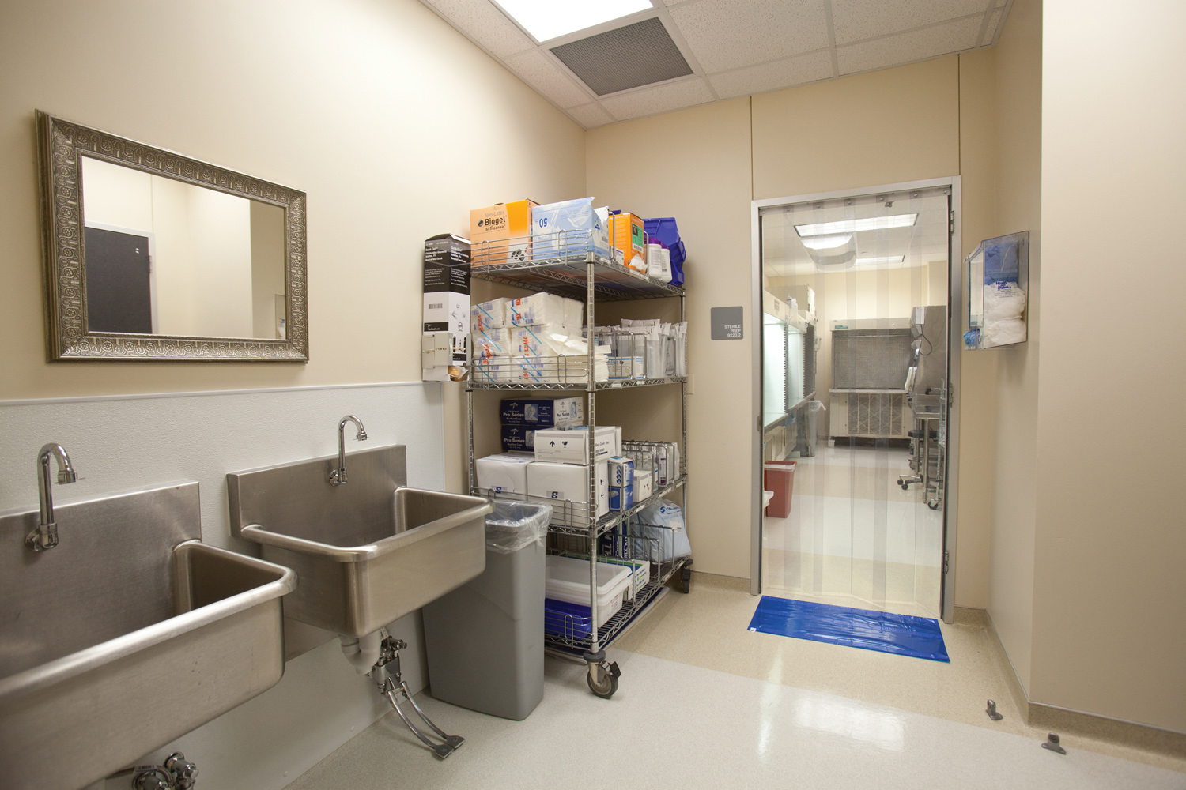
Procedure-Specific Supplies
Designated Sink for Aseptic Hand Washing
USP Chapter <797> regulations describe the features and location of a sink designated for aseptic hand washing
  designed to minimize splashing and reduce the possibility of contamination

Slide 27
Procedure-Specific Supplies…/2
Designated Sink for Aseptic Hand Washing…continued
Must be located in the anteroom or just outside the door of the clean room
Should be deep and have a gooseneck faucet
Foot pedals should be used
  if foot pedals are not available, personnel must let the water run throughout the entire scrub and rinse procedure and then turn off the faucet with lint-free paper towels
Must be clean and free of any items that might cause splashing, such as sponges or IV bags

Slide 28
Procedure-Specific Supplies…/3
Hand-Washing Supplies
As a sterile compounder, you perform a very basic aseptic hand washing by vigorously washing both hands and forearms for at least 30 seconds with an appropriate antimicrobial agent
Many facilities prefer to perform the hand-washing procedure using a sterile, prepackaged, surgical scrub sponge/brush presaturated with an approved antimicrobial soap

Slide 29
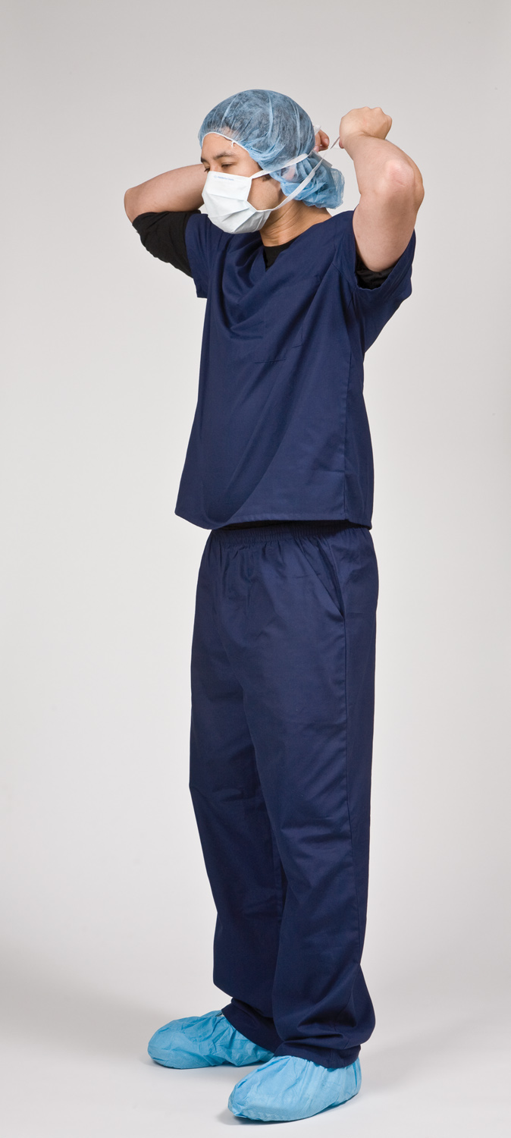
Preview the Lab Procedure
Anteroom Preparatory Procedures
  Garbing
  Aseptic Hand Washing
  Gowning
  Sterile Gloving
Removal of PPE Items

Slide 30
Your Turn
This type of hand cleanser is appropriate for general hand washing, but not acceptable for aseptic hand washing.
  chloroxylenol
  isopropyl alcohol
  triclosan
  iodophors
In Slide Show view, click here to see the answer to Question 3. Then click again to advance to Question 4.
All of the following factors are required for a sink designated for aseptic hand washing except:
  gooseneck faucet
  deep basin that is clear of objects
  restricted use for pharmacy personnel
  clean room location
In Slide Show view, click here to see the answer to Question 4.

