Slide 2
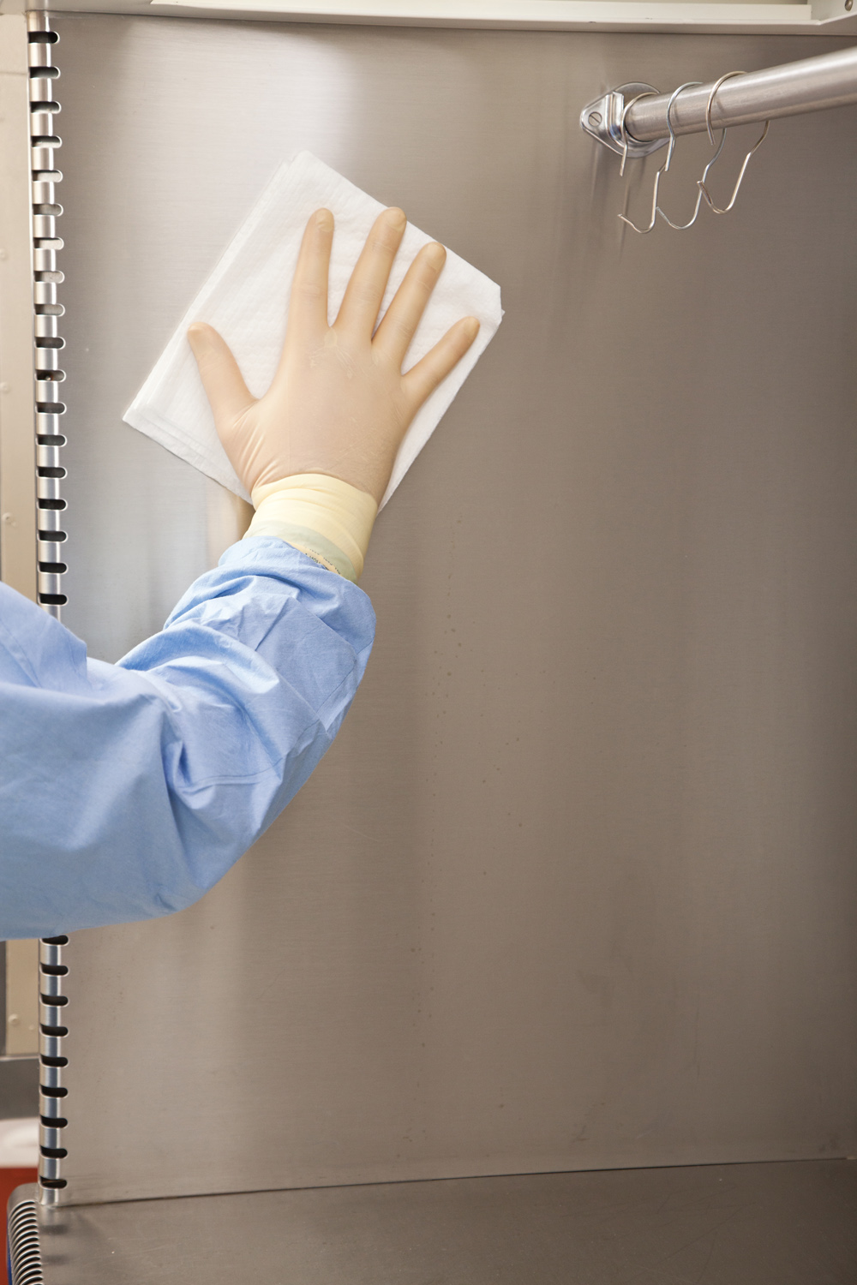
Chapter 7
Cleaning the Horizontal Laminar Airflow Hood

Slide 3
Learning Objectives
Gain an awareness of early cleanliness methods and disinfection practices.
Understand the rationale for using a hood when preparing sterile products.
Describe the components of the horizontal laminar airflow hood.
Explain the proper methods for cleaning the horizontal laminar airflow hood.
Demonstrate excellent technique in the cleaning of the horizontal laminar airflow hood.

Slide 4
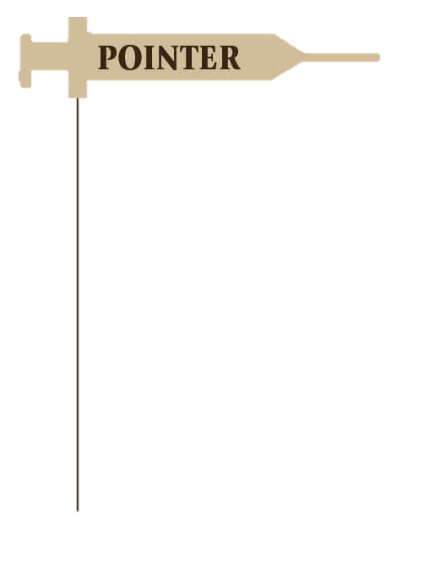
Topics
Learning Objectives
Introduction
Anteroom Preparation
Clean Room Equipment
Components of the Horizontal Laminar Airflow Hood
Operation of the Horizontal Hood
USP Chapter <797> Guidelines for Cleaning the Horizontal Hood
Essential Supplies
Procedure-Specific Supplies
Preview the Lab Procedure
Chapter Summary
In Slide Show view, click the desired topic to the left to link directly to the related slide. To return to this slide at any point in the presentation, click the Topics button below.

Slide 5
Introduction
In addition to adhering to strict aseptic protocol in anteroom and clean room procedures, pharmacy technicians must ensure that the interior of the laminar airflow hood also remains free of contaminants
Proper cleaning of the hood (in this case, the horizontal laminar airflow hood) is vital to maintaining the sterility of CSPs

Slide 6
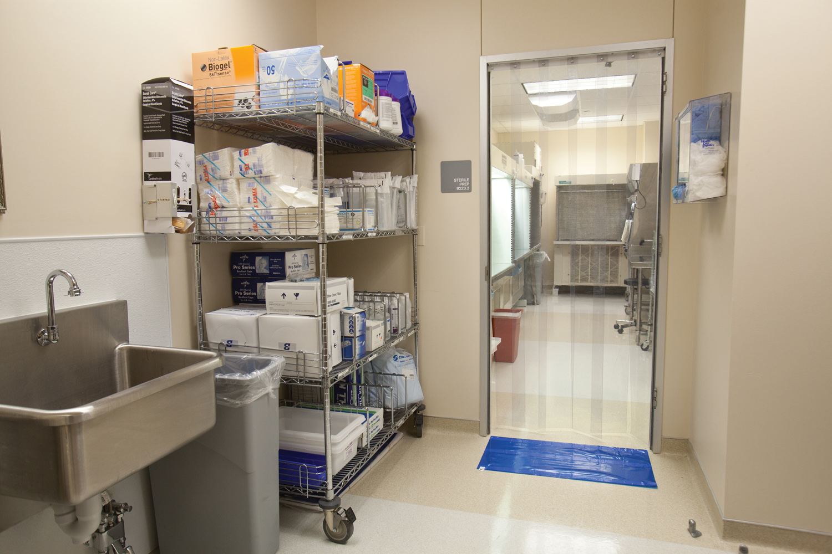
Anteroom Preparation
Although the laminar airflow hood is located in the clean room, preparation for the hood-cleaning process begins in the anteroom

Slide 7
Anteroom Preparation…/2
In the anteroom, the IV technician gathers the required hood-cleaning supplies—including lint-free, aseptic hood-cleaning wipes; sterile water; and sterile 70% IPA—and cleans the exterior surfaces of the supply containers with a presaturated aseptic cleaning wipe
  these steps must be completed before transporting the supplies into the clean room

Slide 8
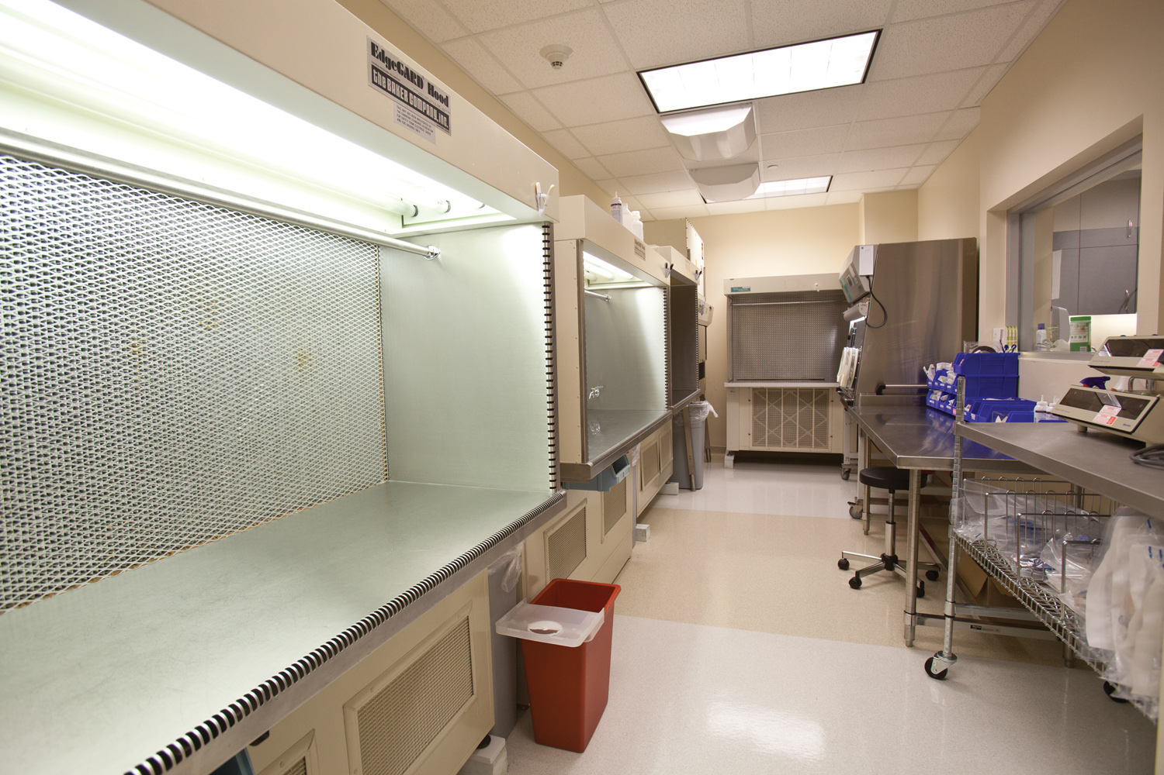
Clean Room Equipment
Within the clean room is the central piece of equipment used in sterile compounding: the laminar airflow hood

Slide 9
Clean Room Equipment…/2
The number of hoods in the clean room is determined by the volume of CSPs that the lab produces; therefore, there may be one or several horizontal laminar airflow hoods within the clean room, as well as a barrier isolator hood
  the vertical laminar airflow hoods used in the preparation of chemotherapy or nuclear medicine are housed in their own separate, negative-pressure room

Slide 10
Components of the Horizontal Laminar Airflow Hood
The horizontal laminar airflow hood, sometimes referred to as the cabinet or workbench, is a surgical steel framework with an interior illuminated by overhead lights
  the components of the hood work in tandem to maintain a controlled air environment through continuous air filtration

Slide 11
Components of the Horizontal Laminar Airflow Hood…/2
The work surface is the stainless-steel surface upon which all sterile compounding procedures take place
  supply items are placed on the work surface within the direct compounding area (DCA), thus allowing HEPA-filtered air to bathe the critical sites of the supply items used to make the CSP

Slide 12
Components of the Horizontal Laminar Airflow Hood…/3
The blower, or fan, is sealed within the rear of the cabinet and is not readily visible
  the blower draws the room air through the prefilter and then pushes it through the HEPA filter and across the work surface of the hood
  this air movement operates at a specific and constant velocity, which creates the Class 5 ISO environment

Slide 13
Components of the Horizontal Laminar Airflow Hood…/4
The prefilter, located in the front or top of the hood, prevents large particles of dust, hair, and other debris from entering the hood
  like other industrial filters, the prefilter must be replaced on a regular basis
  according to USP Chapter <797> guidelines, replacement should occur every 30 days, and these filter changes must be documented

Slide 14
Components of the Horizontal Laminar Airflow Hood…/5
The HEPA filter, located at the back of the hood, behind a protective grill, traps most microbial contaminants, viruses, fungi, bacteria, and other pollutants, many of which are invisible to the naked eye
  the HEPA filter is a permanent filter
  it must be recertified by an independent hood/HEPA filter certification company every six months or every time the hood is moved

Slide 15
Operation of the Horizontal Hood
In a horizontal laminar airflow hood, room air is pulled through the prefilter and drawn to the back of the hood
A blower then pushes the prefiltered air through the HEPA filter, which prevents 99.97% of all airborne particles of 0.5 micron or larger from entering the DCA of the hood
The HEPA-filtered air is then blown horizontally across the work surface toward the worker

Slide 16
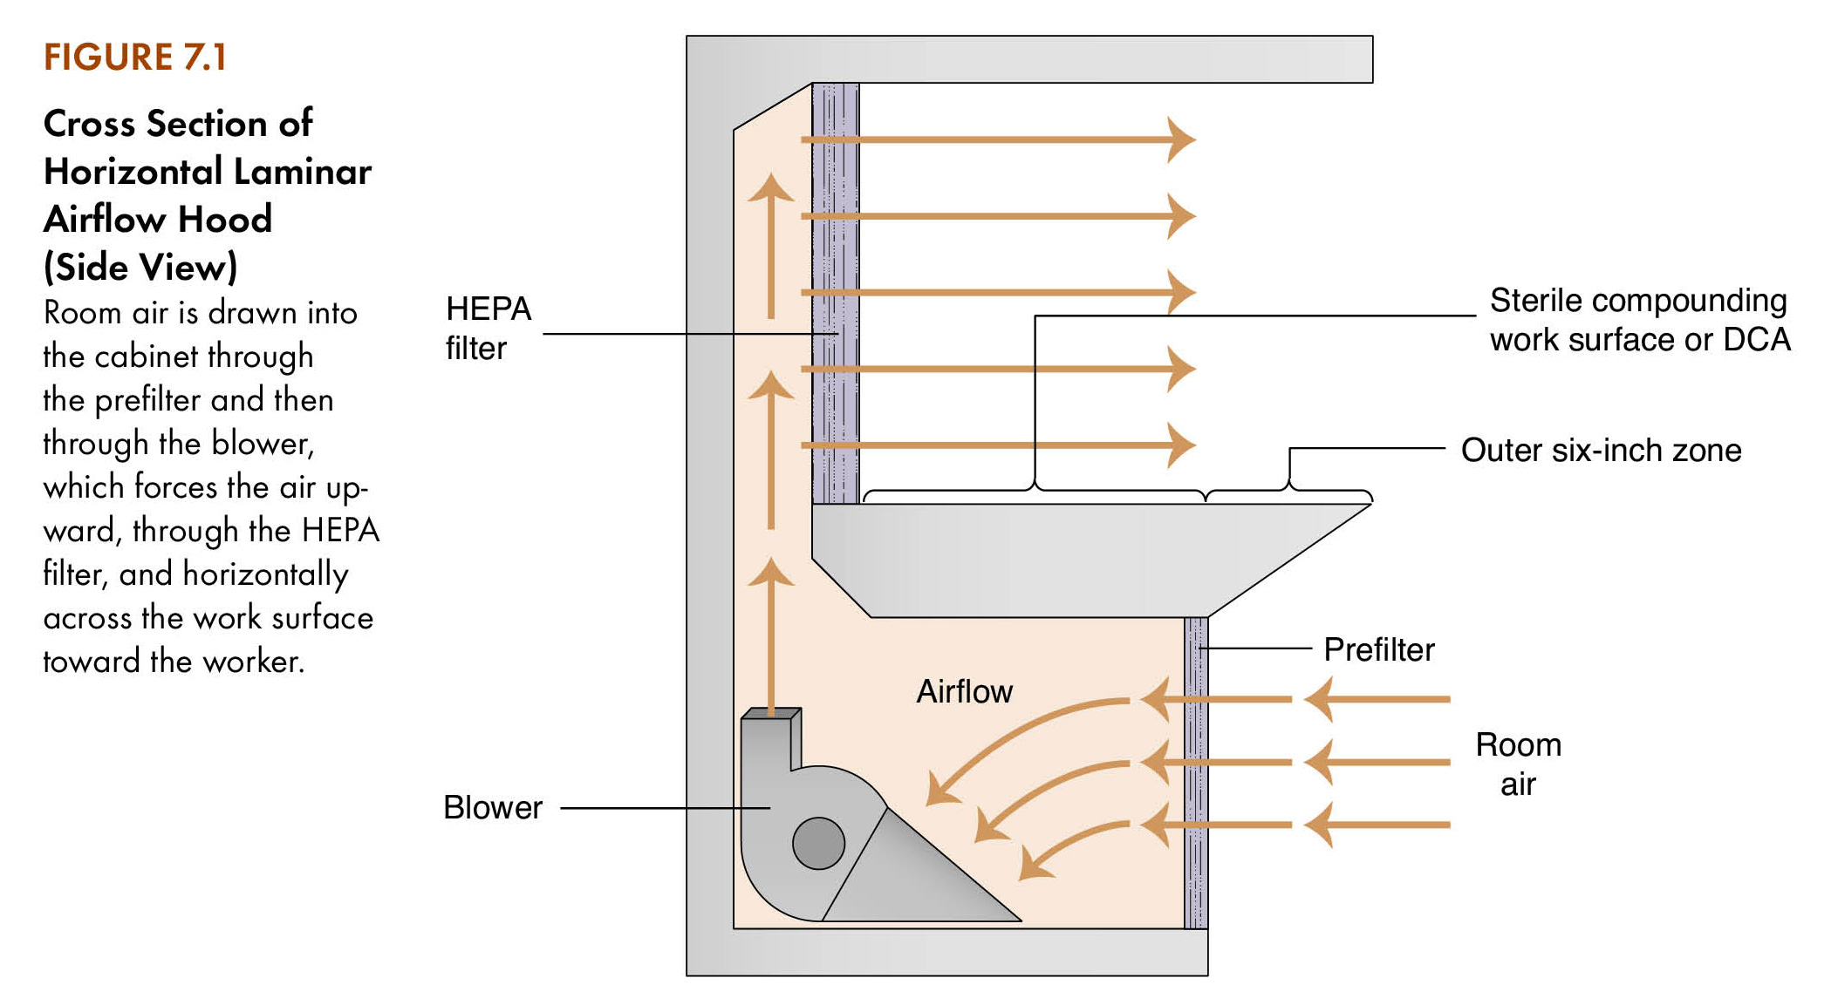
Operation of the Horizontal Hood…/2

Slide 17
USP Chapter <797> Guidelines for Cleaning the Horizontal Hood
The protocol states:
  the minimum timetable for hood cleaning (at the beginning of every shift, before every batch compounding session, and every 30 minutes during continuous sterile compounding)
  any circumstances that dictate repeated cleaning of the hood (after any spills, when surface contamination is known or suspected)

Slide 18
USP Chapter <797> Guidelines for Cleaning the Horizontal Hood…/2
The protocol states…continued:
  the aseptic garbing, hand-washing, and gloving procedures that must be performed by the worker prior to the hood cleaning
  the supplies that must be used for the hood-cleaning procedure, including lint-free, aseptic hood-cleaning wipes; sterile water; and sterile 70% IPA
  the specific order of the hood-cleaning procedure
  the required documentation of the hood-cleaning process

Slide 19
Your Turn
  This is located at the back of the hood, behind a protective grill, and traps most microbial contaminants.
  prefilter
  blower
  HEPA filter
  work surface
In Slide Show view, click here to see the answer to Question 1. Then click again to advance to Question 2.
What is the minimum timetable for hood cleaning during continuous sterile compounding?
  10 minutes
  15 minutes
  25 minutes
  30 minutes
In Slide Show view, click here to see the answer to Question 2.

Slide 20
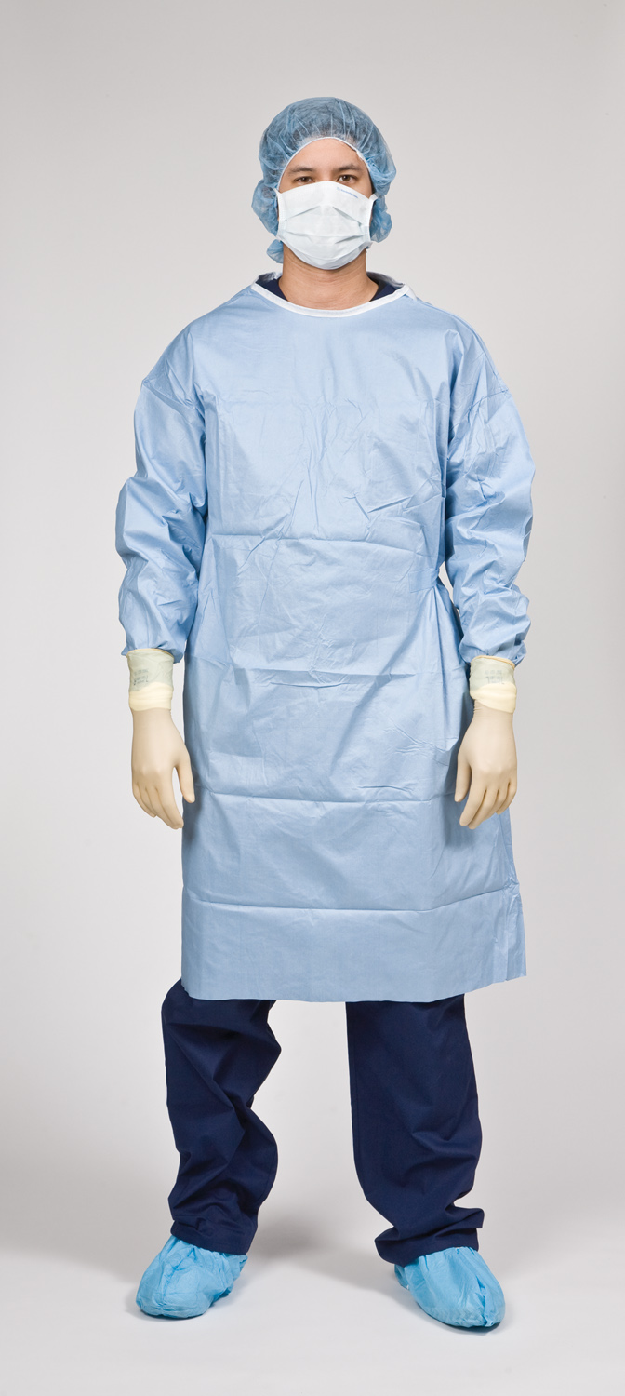
Essential Supplies
For the anteroom, the essential supplies include a pen or pencil; a permanent, felt-tip marker; sterile, foamed 70% IPA; aseptic garb, such as shoe covers, hair cover, face mask, and a beard cover (if appropriate); and sterile garb such as a sterile gown

Slide 21
Essential Supplies…/2
Other essential items include supplies needed for aseptic hand washing, such as an acceptable cleansing agent (for example, chlorhexadine gluconate) and aseptic, lint-free, disposable towels or an aseptic hand dryer
For the clean room, essential supplies include sterile, foamed 70% IPA; sterile, powder-free gloves; a waste container; a sharps container; and a laminar airflow hood (in this case, a horizontal laminar airflow hood)

Slide 22
Procedure-Specific Supplies
Hood-Cleaning Supplies – Presaturated Cleaning Wipes
To avoid the introduction of contaminants into the clean room, the entire exterior surface of each supply item must be wiped down with presaturated cleaning wipes
  the items should then be allowed to dry before being taken into the clean room

Slide 23
Procedure-Specific Supplies…/2
Hood-Cleaning Supplies – Lint-Free, Aseptic Hood-Cleaning Wipes
The hood must be cleaned with lint-free, nonshedding, aseptic wipes
  if this type of hood-cleaning wipe is not available, sterile gauze is an acceptable substitute
  if large wipes are used to clean the hood, bring 10–12 wipes
  if sterile gauze pads are used, bring approximately a four-inch stack to clean the entire hood

Slide 24
Procedure-Specific Supplies…/3
Hood-Cleaning Supplies – Sterile Water
Sterile water is used to remove the sticky compounding residue that is insoluble to IPA, the primary agent used to disinfect the hood
  once the bottle is opened, the sterile water should be poured onto the aseptic wipes and then used to wipe down the hood surfaces

Slide 25
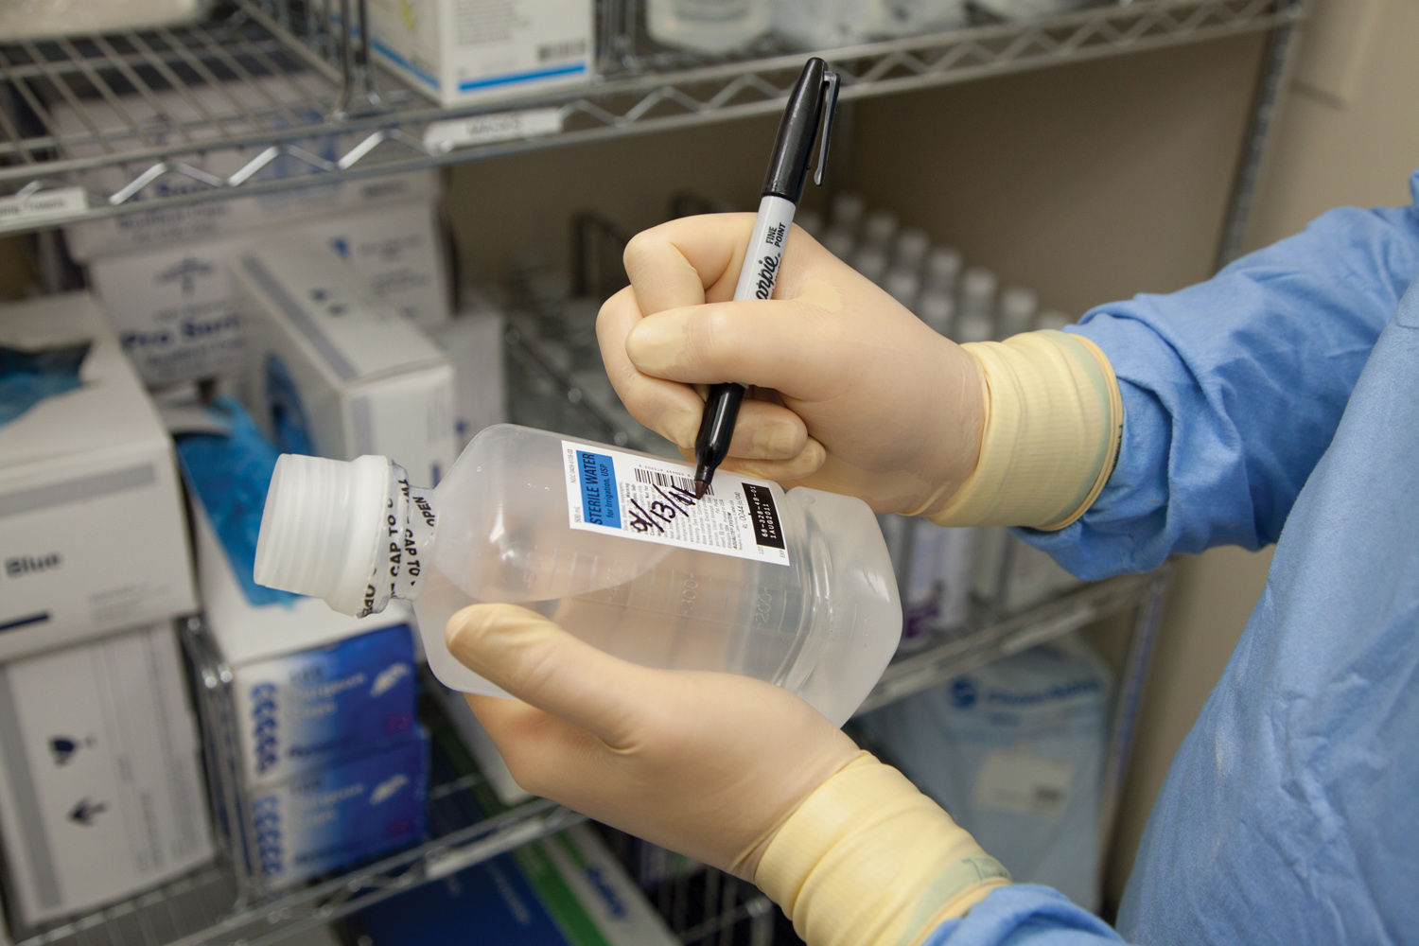
Procedure-Specific Supplies…/4
Hood-Cleaning Supplies – Sterile Water…continued
When the task is completed, the IV technician should record the opening date and time on the bottle’s label

Slide 26
Procedure-Specific Supplies…/5
Hood-Cleaning Supplies – Sterile 70% IPA
Sterile 70% IPA is used as the primary hood-cleaning disinfectant because it kills or inhibits the growth of microorganisms
  the alcohol should be supplied in a 473-mL (or larger) pour bottle that can be recapped to keep the alcohol from becoming contaminated between hood cleanings

Slide 27
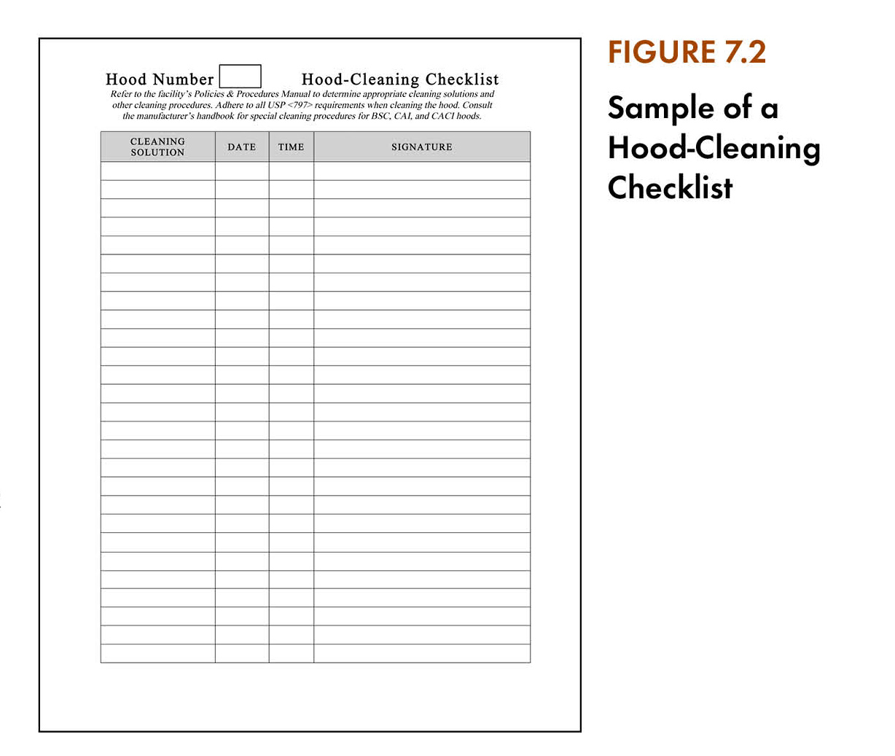
Procedure-Specific Supplies…/6
Hood-Cleaning Supplies – Hood-Cleaning Documentation
The hood-cleaning checklist is kept in the anteroom inside of a plastic sheet protector, or some other easily wiped container

Slide 28
Procedure-Specific Supplies…/7
Hood-Cleaning Supplies – Hood-Cleaning Documentation…continued
The checklist is an official document that may be reviewed by regulatory and compliance organizations
It is the IV technician’s responsibility to fill out the hood-cleaning checklist whenever the hood-cleaning procedure is performed
  if there is more than one hood located in the clean room, a separate hood-cleaning checklist should be maintained for each hood

Slide 29
Preview the Lab Procedure
Anteroom Preparatory Procedures
Gathering and Cleaning of Supplies
  the outside of the containers of alcohol and water must be sprayed with a suitable cleansing agent or wiped down with presaturated cleaning wipes prior to entering the clean room in order to remove dust or other contaminants
Donning PPE
  hand-washing procedures are mandatory and must be performed prior to donning a sterile gown

Slide 30
Preview the Lab Procedure…/2
Clean Room Preparatory Procedures
Arranging Supplies in the Hood
  the wipes should be placed at least six inches inside of the hood because the outer six-inch edge of the work surface is exposed to potentially contaminated room air

Slide 31
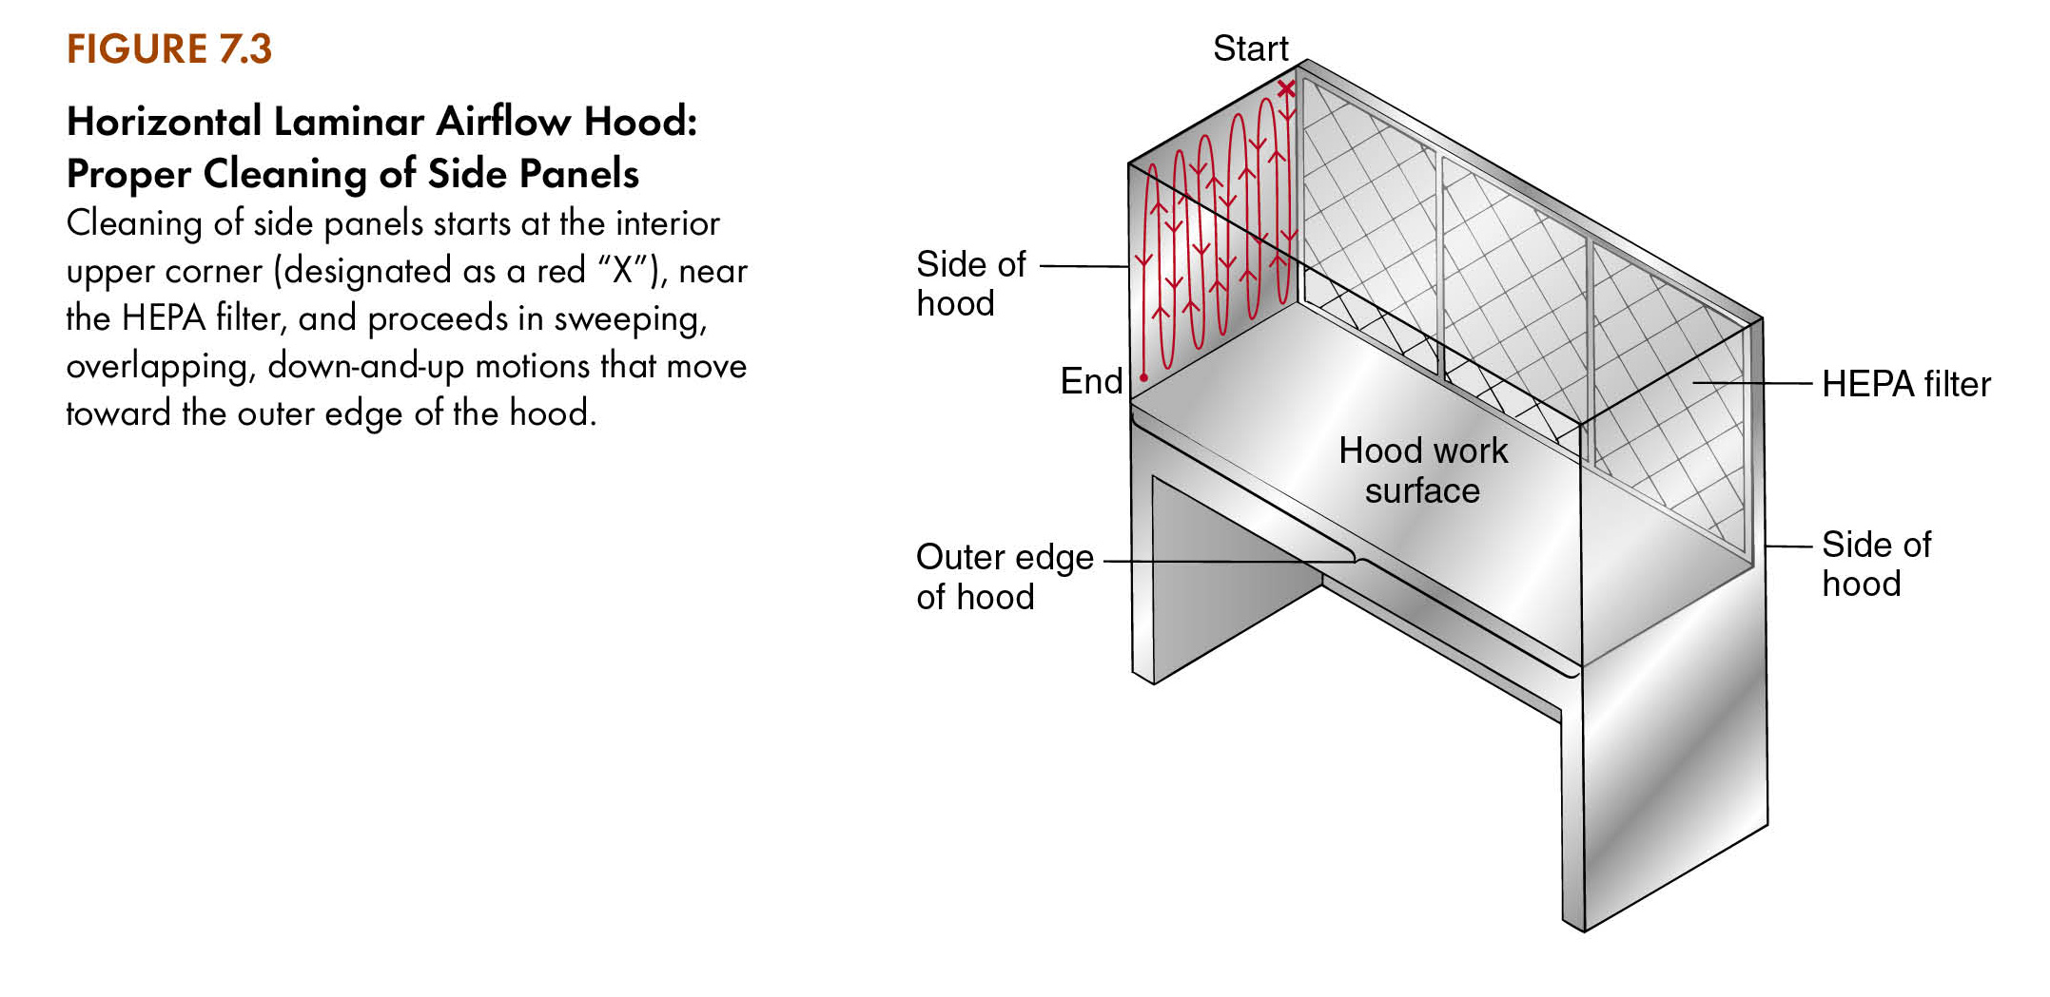
Preview the Lab Procedure…/3
Hood-Cleaning Procedure

Slide 32
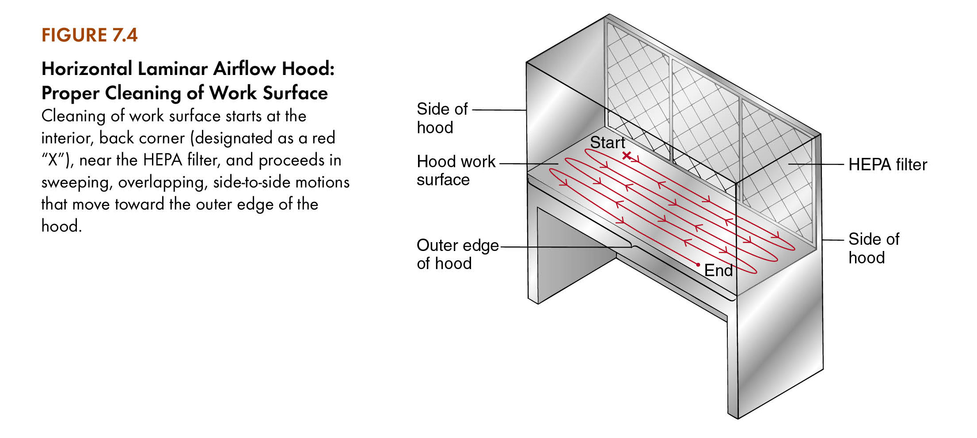
Preview the Lab Procedure…/4
Hood-Cleaning Procedure…continued

Slide 33
Preview the Lab Procedure…/5
Hood-Cleaning Procedure…continued
Avoid using short, staccato, back-and-forth strokes as they create turbulence in the sterile airflow and may cause you to miss small portions of the hood during the cleaning procedure
Once the initial hood cleaning has been completed using the sterile water, you must repeat the process using the sterile 70% IPA

Slide 34
Preview the Lab Procedure…/6
Completing the Checklist and Removing PPE
Upon completion of the hood-cleaning procedure, return to the anteroom
Complete the hood-cleaning checklist by recording the date, time, and your name or initials as required
Remove your PPE in the opposite order in which you put them on

Slide 35
Your Turn
  If large wipes are used to clean the hood, bring this many wipes.
  4–6
  7–9
  10–12
  13–15
In Slide Show view, click here to see the answer to Question 3. Then click again to advance to Question 4.
This is used to remove the sticky compounding residue that is insoluble to IPA.
  alcohol
  gauze
  antiseptic wipes
  sterile water
In Slide Show view, click here to see the answer to Question 4.

